Slide 1





DOG BREED RECOGNITION SYSTEM
BY
CHAITANYA SONI & KRISHNA AGARWAL

Slide 2

QUICK DEMO

Slide 3

Welcome To Our
Project
A dog breed recognition web application using ResNet50V2 allows users to upload dog images and obtain predictions of the dog breed. It utilizes the ResNet50V2 deep learning model, pretrained on a large dataset, to process the images and provide accurate breed classification. The web app provides a user-friendly interface for uploading images, running them through the model, and displaying the predicted breed along with the image for easy interaction.

Slide 5

Is This Identifier
Really Required ??
Adoption and Placement
Health and Care
A dog breed identifier helps shelters and rescue organizations accurately identify the breed of a dog, assisting in finding suitable homes and matching dogs with potential adopters based on their preferences and lifestyle.
Knowing a dog's breed can help veterinarians anticipate and address breed-specific health issues, ensuring appropriate medical care, preventive measures, and early detection of potential health conditions.
Training and Behavior
Legal & Housing Considerations
Different dog breeds have distinct temperaments, energy levels, and behavior tendencies. A breed identifier aids trainers and behaviorists in understanding a dog's needs, designing effective training programs, and addressing behavioral challenges specific to the breed..
Breed-specific legislation and housing restrictions may exist in certain areas. Identifying a dog's breed helps owners comply with legal requirements, navigate housing restrictions, and ensure responsible pet ownership within the legal framework.

Slide 6

Description Of
The Problem
The problem with dog breed identification stems from the difficulty in accurately determining the breed or breed mix of a dog. This issue arises when the dog's lineage or heritage is unknown or uncertain. Determining the breed is important for various reasons, including understanding the dog's specific characteristics, potential health issues, and suitable training approaches. However, visual assessment alone is often insufficient, particularly with mixed-breed dogs or those lacking pedigrees. Consequently, a reliable dog breed identifier is needed to provide accurate and consistent identification based on physical traits, behavior patterns, or genetic analysis. Such an identifier would assist shelters in finding appropriate homes, aid veterinarians in providing targeted healthcare, assist trainers in developing tailored training plans, and enable compliance with legal or housing restrictions related to specific breeds. Additionally, it would satisfy the curiosity of dog owners regarding their pet's breed heritage.

Slide 7

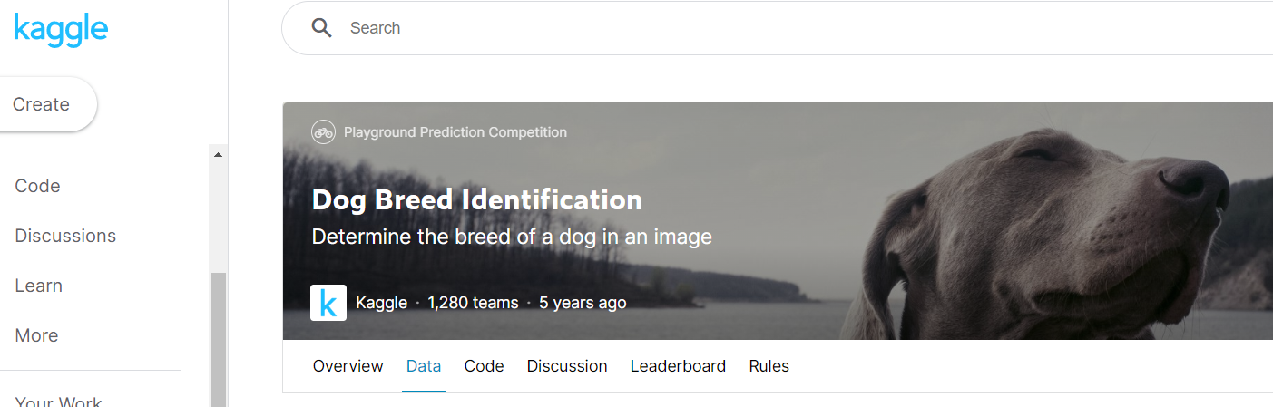
Description Of
The Dataset
The dataset used was from Kaggle, and is publicly available at www.kaggle.com/competitions/dog-breed-identification/data. In order to keep the identifier simple & accurate, I used the image data available with 10K+ images to accurately identify the breed. The dataset has [id, breed, image_address] columns which is used to train the model perfectly and accurately. The dataset was first made public in 2017 by Will Cukierski.

Slide 8















Work Flow Of The Model
AlgorithmSelection
Training Data Collection
Importing Libraries
Image
Data Cleaning
User
Data Increment
Train-Test Split
Image Data to Array
Model Building
Edit Data for Web Scrapper
Label Encoding
Model Testing & Evaluation

Slide 9

Algorithm Used
ResNet50V2
ResNet50V2 is an upgraded variant of the ResNet50 model, renowned for its excellence in computer vision tasks. With an architecture comprising 50 layers, ResNet50V2 introduces improvements to enhance performance and address limitations. It incorporates bottleneck blocks, which consist of three convolutional layers of varying filter sizes, to reduce computational complexity while capturing significant features in the data. By employing skip connections, the model mitigates the problem of vanishing gradients, enabling effective training of deep networks.
The structure of ResNet50V2 includes convolutional layers, batch normalization layers, and fully connected layers. It is commonly used for image classification and other computer vision applications due to its exceptional performance. Pretraining on extensive image datasets such as ImageNet equips the model with a robust understanding of visual features.
ResNet50V2 is often leveraged as a feature extractor, utilizing the hierarchical features learned by the model for downstream tasks. Additionally, it can be fine-tuned to adapt to specific application domains and achieve even better performance. Its deep architecture and advanced design make it a powerful tool in the field of computer vision, enabling state-of-the-art results in various tasks.

Slide 10
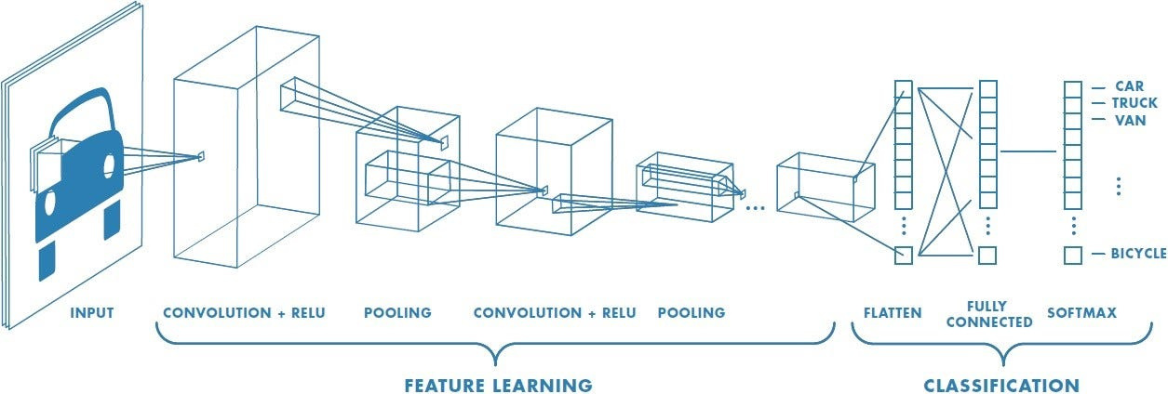
CNN : The Basic Working

Slide 11
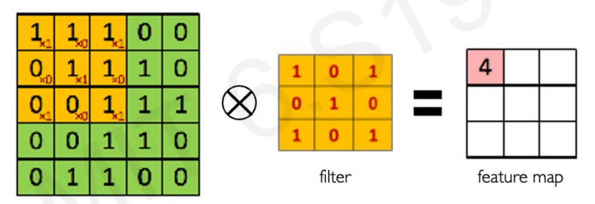
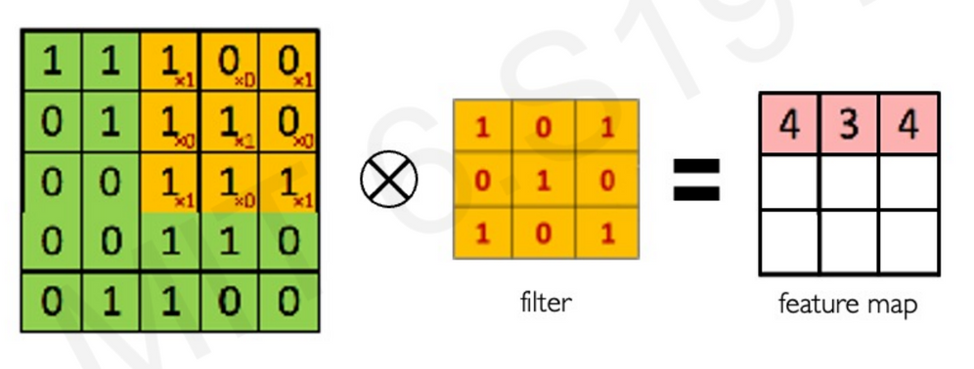
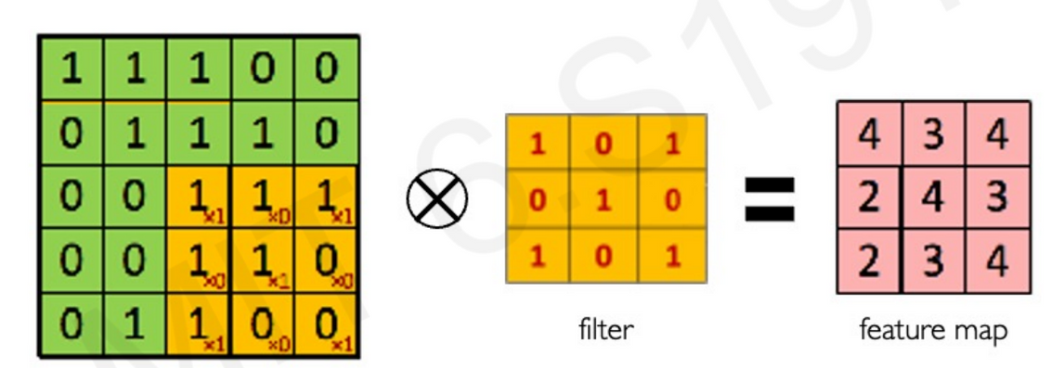
Convolutional Neural Networks
The Basic Terms : Convulution

Slide 12
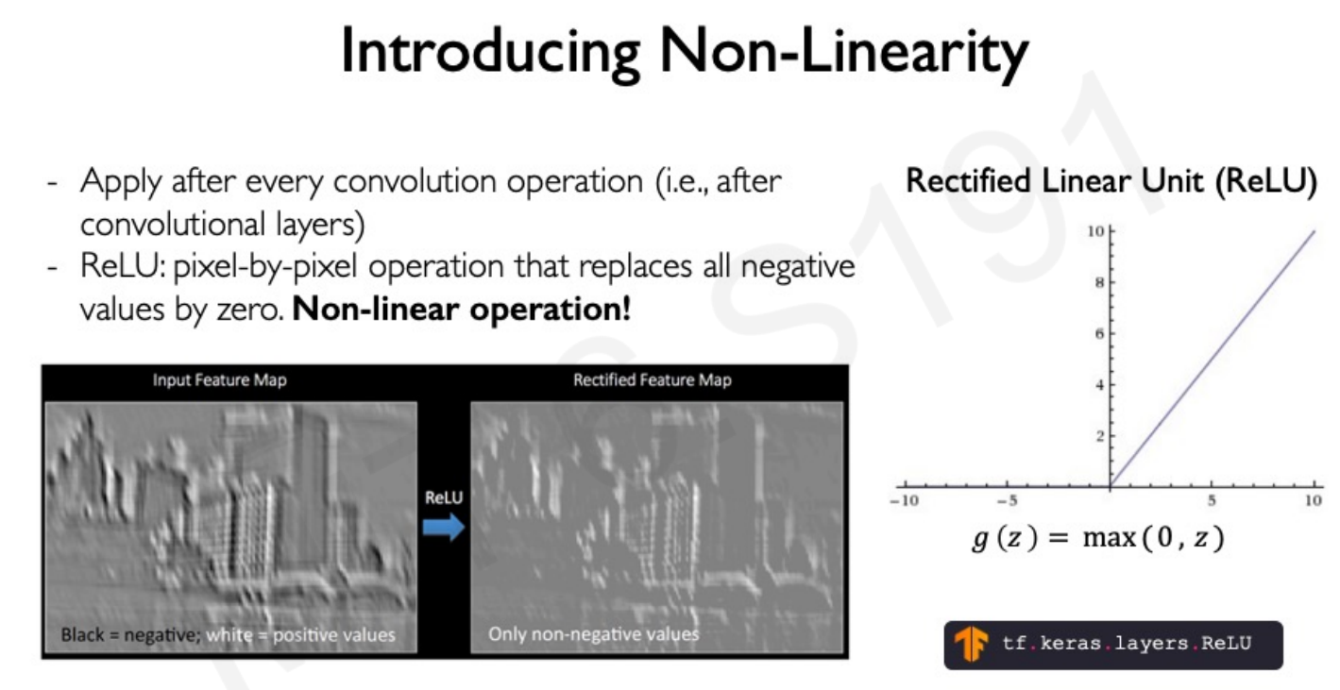
Convolutional Neural Networks
The Basic Terms : ReLu (Activation)

Slide 13
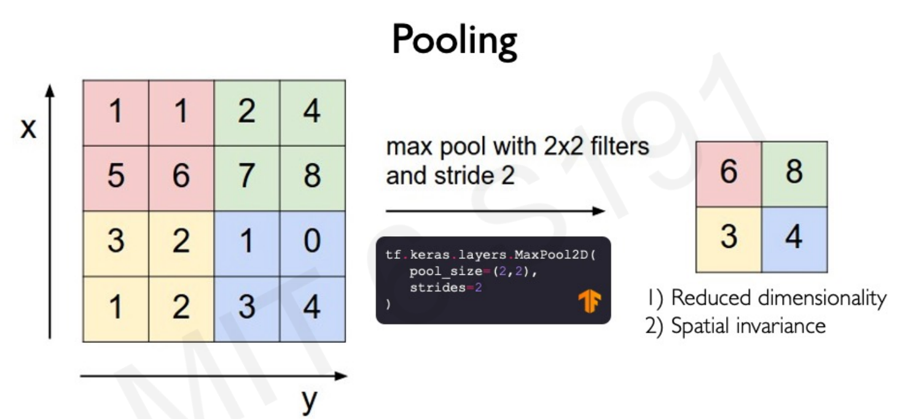
Convolutional Neural Networks
The Basic Terms : Pooling

Slide 14
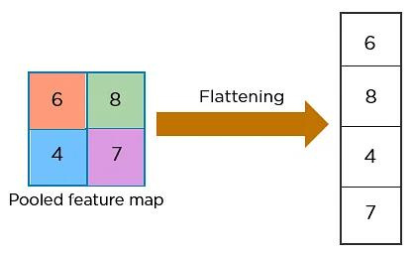
Convolutional Neural Networks
The Basic Terms : Flatten

Slide 15

Convolutional Neural Networks
The Basic Terms : Softmax

Slide 16
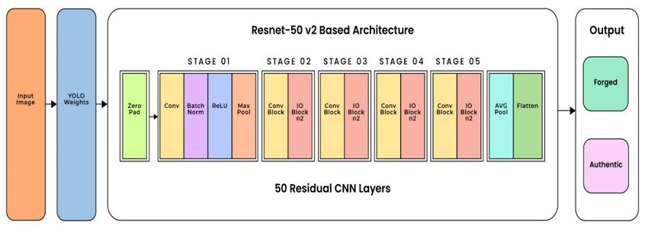
Working of the ResNet50V2

Slide 17
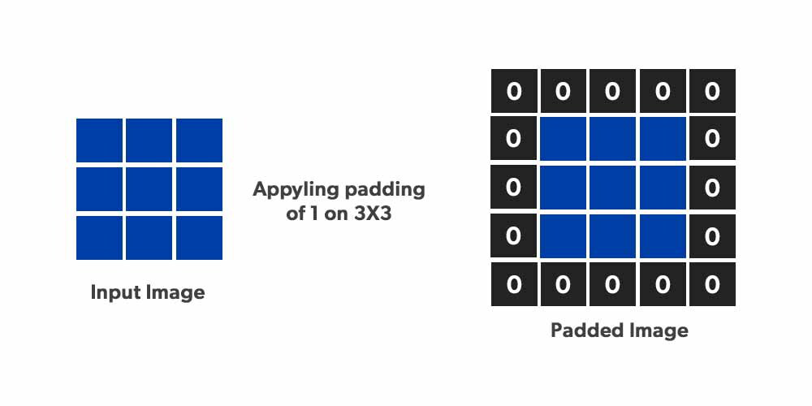
ResNet 50 V2
The Terms : Padding

Slide 18
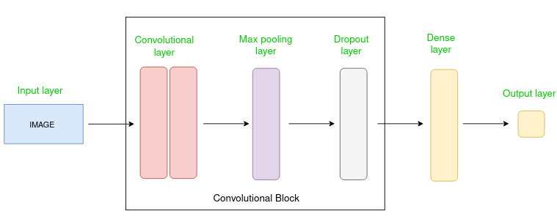
ResNet 50 V2
The Terms : Conv Block

Slide 19
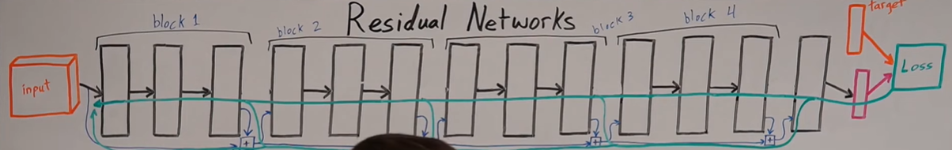
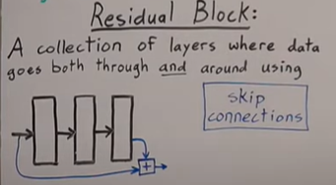
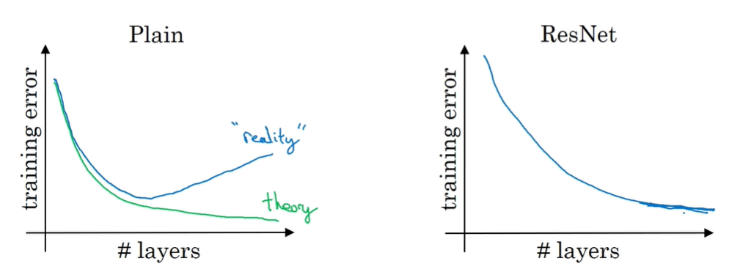
ResNet 50 V2
The Terms : Blocking
Sum / Concat

Slide 20
ResNet 50 V2
The Terms : Batch Normalization
Batch normalization is a method used to make training of artificial neural networks faster and more stable through normalization of the layers' inputs by re-centering and re-scaling.
Using MEAN, VARIANCE, ETC.

Slide 21

A Short Note
Streamlit
Streamlit is an open-source Python library used for building web applications and interactive data visualizations. It is specifically designed to simplify the process of creating interactive dashboards, machine learning models, data exploration tools, and other data-driven applications. Streamlit provides an intuitive and user-friendly way to create web interfaces directly from Python scripts. With minimal code, you can create interactive web applications that allow users to interact with your data, visualize results, and manipulate parameters.
Easy-to-use: Streamlit provides a simple and declarative syntax, allowing you to create interactive web apps with just a few lines of code.
Rapid prototyping: With automatic hot reloading, you can see the changes you make to your code immediately, making it ideal for rapid iteration and prototyping.
Seamless integration: Streamlit integrates well with popular data science libraries and frameworks such as Pandas, Matplotlib, and scikit-learn, allowing you to leverage their functionality within your web app.
Sharing and deployment: Streamlit makes it easy to share your web apps with others. You can deploy your Streamlit app on various platforms, including cloud services like Heroku, or you can use Streamlit for Teams, which is a managed platform for deploying and collaborating on Streamlit apps.

Slide 22
Now We Take A Look At The Python Code Jupyter Notebook & Also The Streamlit (Used PyCharm IDE)

Slide 23
THANK YOU

